Slide 1
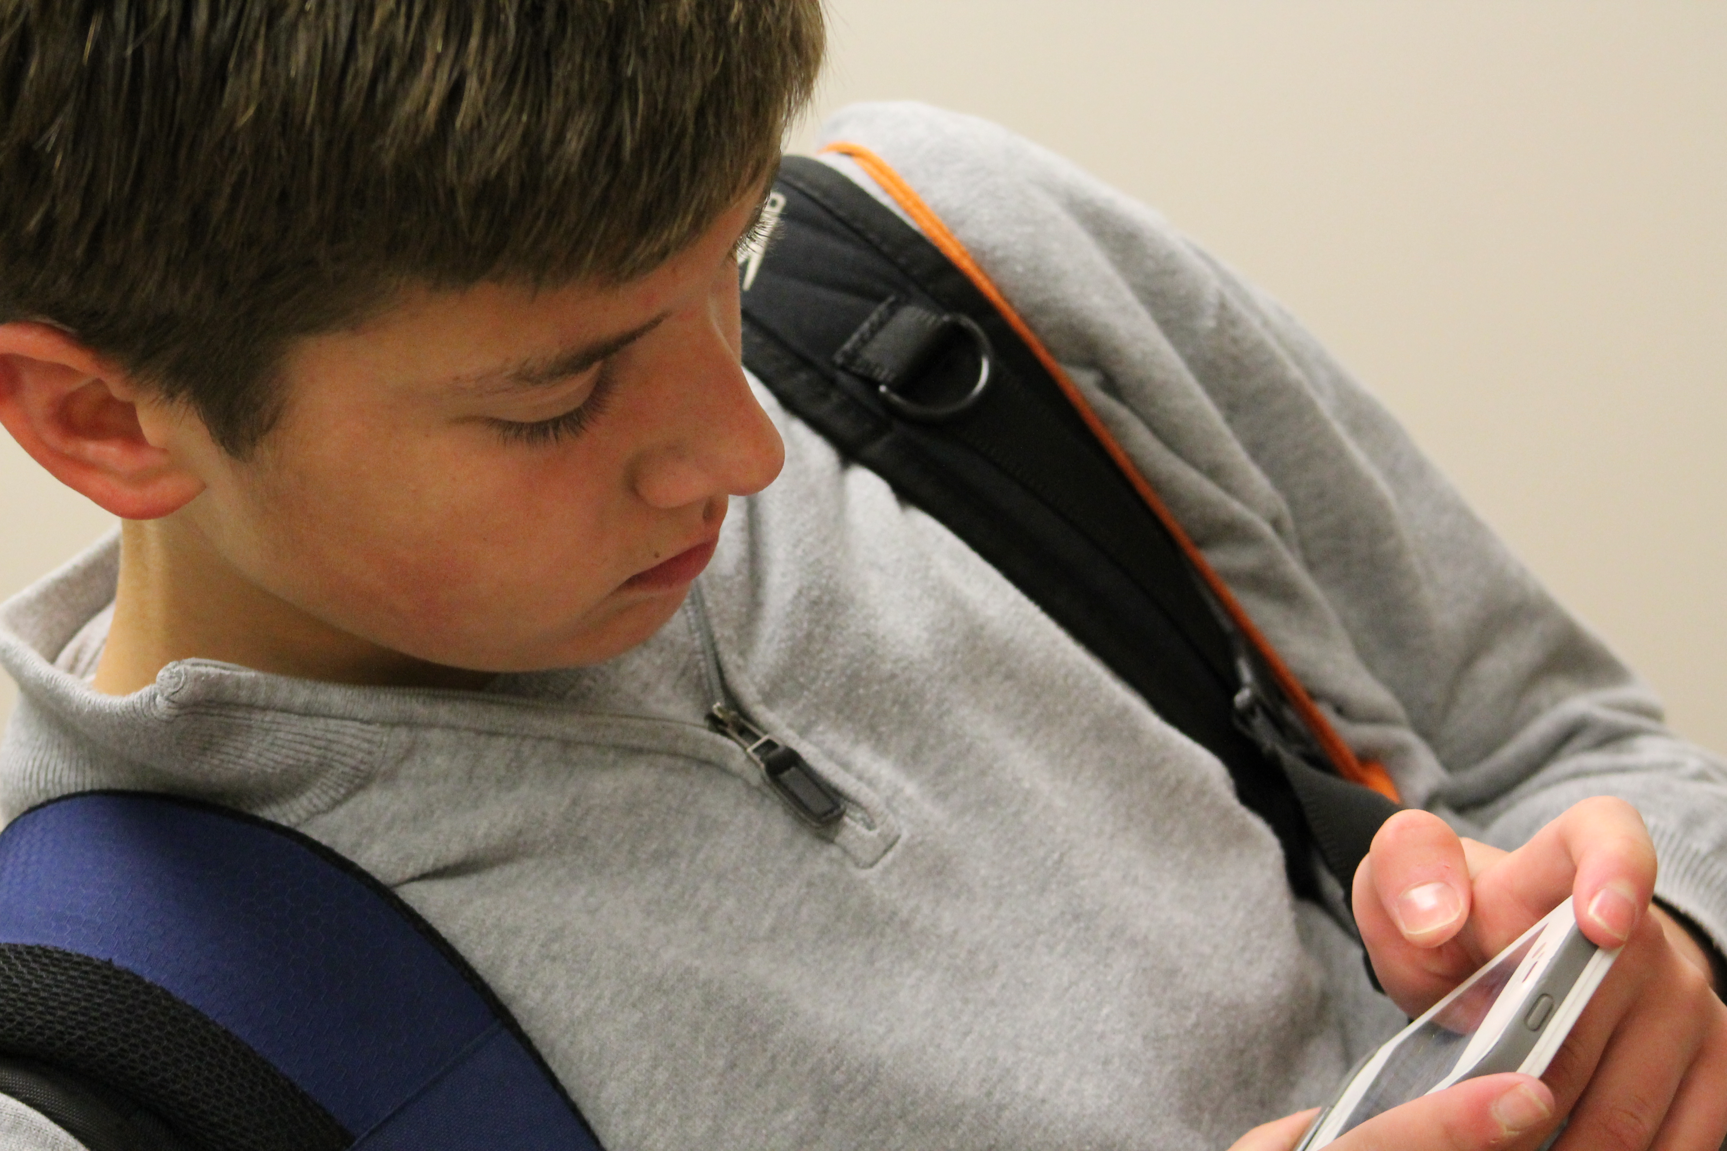
Parenting iGen/Gen Z
Keeping Up and Keeping Balance

Slide 2
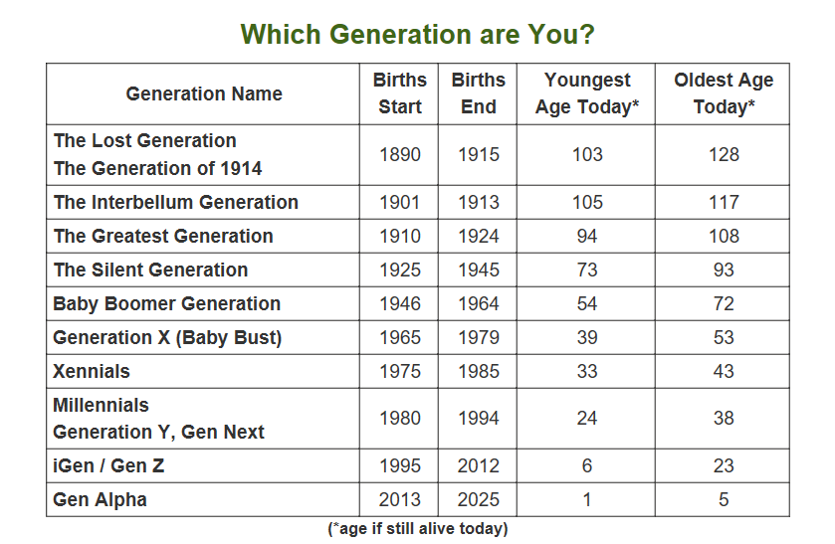
Generations

Slide 3
Tech-Related Stats – Gen Z
95% ages 13-22 has a smartphone
Over half use their phone for 5 or more hours a day
26% use it 10 or more hours each day
Females use their phones more than males, especially for social media
65% say they are on their smartphones after midnight a few times a week. 29% say they are on their smartphones at this time every night!
58% feels uncomfortable if they don’t have their phones for a few hours or less.
Ages 8-11, 91% of boys and 93% of girls play games online
Teens spend 2 hours twenty minutes online and 1 hour and 50 min is on social networks
40% are self-identified digital device addicts

Slide 4
Concerning Observations of iGen
Less F2F time with friends and loved ones leading to lack of social skills
Unprecedented levels of anxiety, depression, and loneliness​
Too much screen time can limit the opportunity to build trust between people that builds empathy and understanding.
Heavy use of gaming
Less reading of books and newspapers
More supervised, more protected than prior generations
Less experience with teen jobs and earning money in high school
May stay up till 2 AM using smart phone and social media
Tend to think they aren’t needed
Possibly a higher suicide rate

Slide 5
Happy Observations
Much more tolerant of others - different cultures, sexual orientations, races
More cautious, less risk taking
Less drinking and drug taking in high school
More likely to think for themselves and not believe authority figures in church or government
Delaying having serious romantic relationships
Less teen pregnancy
Fewer run aways
Delaying driving, and fewer teen driving accidents
Less time spent in shopping malls

Slide 6

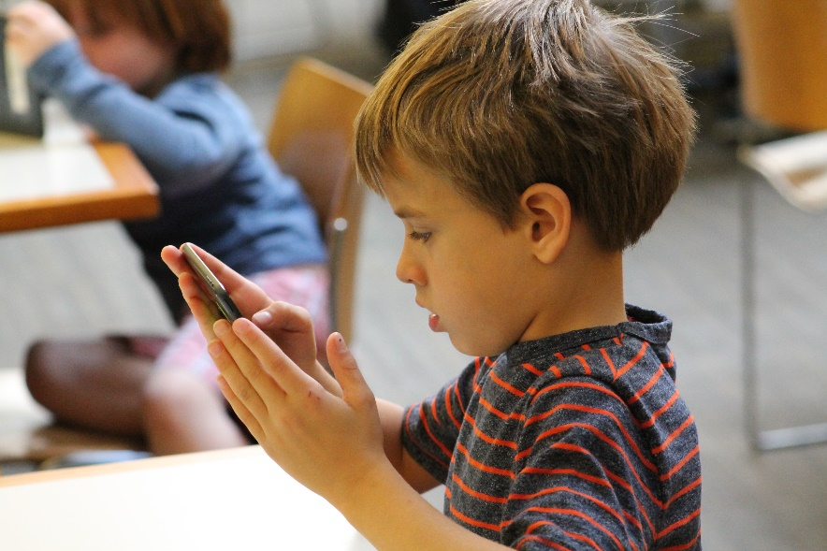

Hiding in Plain Sight
Gaming and virtual games can create universes for kids to hide in​
When asked why one’s phone was important, a young teen reported: “I can look busy in awkward situations.”
  Using technology as a curtain to mask uncomfortable social situations

Slide 7




What are they doing?
Social media, but different apps for different purposes
YouTube is huge. And they trust the advertising there more than any other source.
Instagram, Snapchat, Facebook (for group events)

Slide 8

Screen Time is Passive
39% watching video
29% social networking
29% playing video games
3% creating

Slide 9
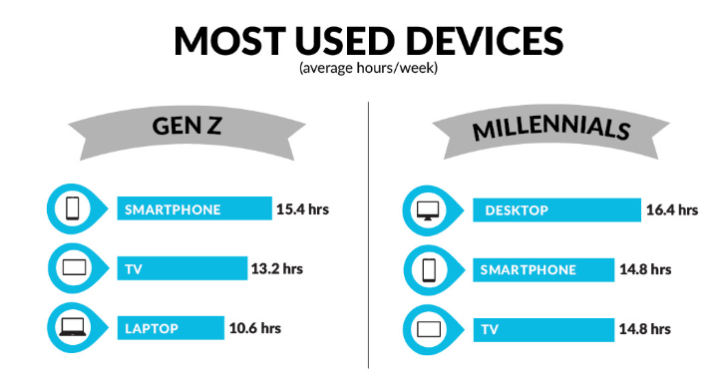

Slide 10
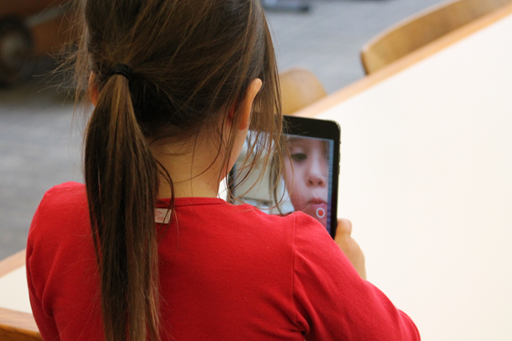
Key Recommendations/ Ideas
Don’t be silent or invisible
Modeling: Adults can have limit setting issues themselves around screen time…and kids see this.​
Agree to terms
  Perhaps a tech contract crafted together
  Devices don’t stay in rooms at night
  Perhaps no devices an hour before bed time
Tech-free days or times (Dinner, Bedtime, Weekends)
Family discussions: Tech talk Tuesdays​
Seek face to face activities, sports, and exercise​
Know what your child is doing/posting online​
Apps that help limit screen time or apps etc. on phones​
Use care when eliminating devices as consequences

Slide 11
Q & A

